Slide 1
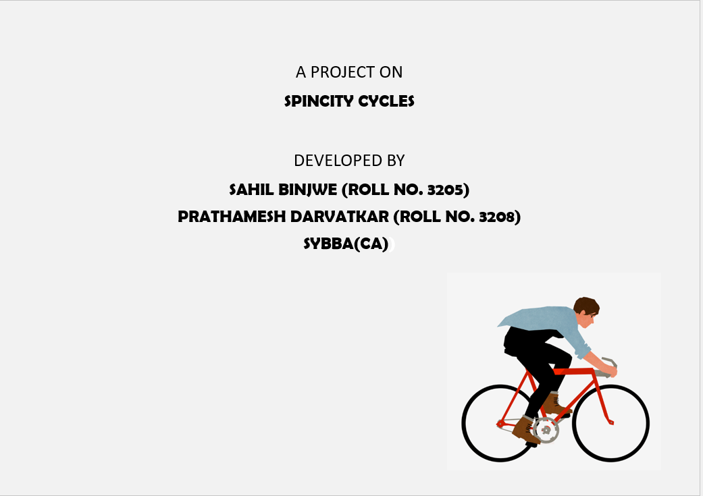

Slide 2
Index
SR NO. | TOPIC
01 | ABSTRACT
02 | INTRODUCTION
03 | OBJECTIVES
04 | ADVANTAGES AND DISADVANTAGES
05 | LANGUAGES
06 | BENEFITS
07 | USER INTERFACE
08 | IMPLEMENTATION
09 | CONCLUSION
10 | FUTURE SCOPE
11 | BIBLIOGRAPHY

Slide 3
1) ABSTRACTI
This website aims at providing a seamless and efficient platform for buying cycles.
Spincity Cycles website incorporates advanced search functionalities, intuitive user interfaces to enhance the overall user experience.
Key features include real-time cycle purchase and integrated customer support mechanisms.
The website ensures ease of navigation and accessibility across various devices.
This website strives to set a new standard in the industry by prioritizing user satisfaction and technological innovation.

Slide 4
2) INTRODUCTION
Spincity Cycles website is a software system where the process of buying cycles is computerized.
This website is designed using HTML and CSS language.
In this project the customer details are maintained and buying process of cycle by the customers are computerized and the management is done without any difficulty.
Users can access these platforms from any location with an internet connection, making renting more accessible to a global audience.
To enroll into the website, customer has to register on the portal. The web application is user-friendly and easy to use. There is Login-screen if a customer had already register.

Slide 5
3) OBJECTIVES
Provide Access to Quality Products: The primary goal of our Cycle Shop website is to offer a diverse and carefully curated selection of bicycles and apparel from leading brands in the cycling industry.
Promote Sustainability: Spincity Cycles website is committed to raise awareness about the environmental benefits of cycling as a sustainable mode of transportation and lifestyle choice.
Deliver Exceptional User Experience: Our goal is to provide users with a user-friendly interface, easy navigation, and efficient search functionality, allowing them to find and purchase products quickly and effortlessly.

Slide 6
4) ADVANTAGES
E-commerce Functionality: Spincity Cycles website will provide a platform for users to purchase a wide range of bicycles online.
Device Compatibility: The website will be optimized for desktop to ensure a seamless browsing and shopping experience for users accessing the site from computers and laptops.
Convenience and Accessibility: Customers can shop anytime, anywhere, eliminating the need to visit physical stores. The 24/7 accessibility enhances convenience, particularly for busy individuals or those with tight schedules.
Customer Reviews : Access to customer reviews allows potential buyers to gauge the quality and performance of products, contributing to a more transparent and trustworthy shopping environment.

Slide 7
DISADVANTAGES
Limited Physical Inspection: Customers cannot physically examine bicycles before purchasing, potentially leading to dissatisfaction if the product doesn't meet their expectations.
Sizing Challenges: Choosing the right size online can be tricky, increasing the likelihood of discomfort or inconvenience if the bicycle doesn't fit the customer properly.
Lack of Test Rides: Online shops often don't offer the option for test rides, making it challenging for customers to experience the feel of the bicycle before making a purchase decision.

Slide 8
5) LANGUAGES USED:
HTML
CSS
JAVASCRIPT
BOOTSTRAP

Slide 9
6) BENEFITS
Increased Visibility: It provides a platform to showcase your products and services to a wider audience, potentially increasing your customer base.
Convenience: Customers can browse and purchase products online, offering them convenience and flexibility in shopping.
Information Accessibility: You can provide detailed information about your products, including specifications, reviews, and pricing, aiding customers in making informed purchasing decisions.
24/7 Availability: Unlike physical stores, your website is accessible round the clock, allowing customers to shop at any time that suits them.
Customer Engagement: Through features like live chat, you can engage with customers, address their queries, and provide valuable content related to cycling.
6. Competitive Advantage: Having a well-designed and user-friendly website can differentiate your cycle shop from
competitors and position your brand as modern and professional.

Slide 10
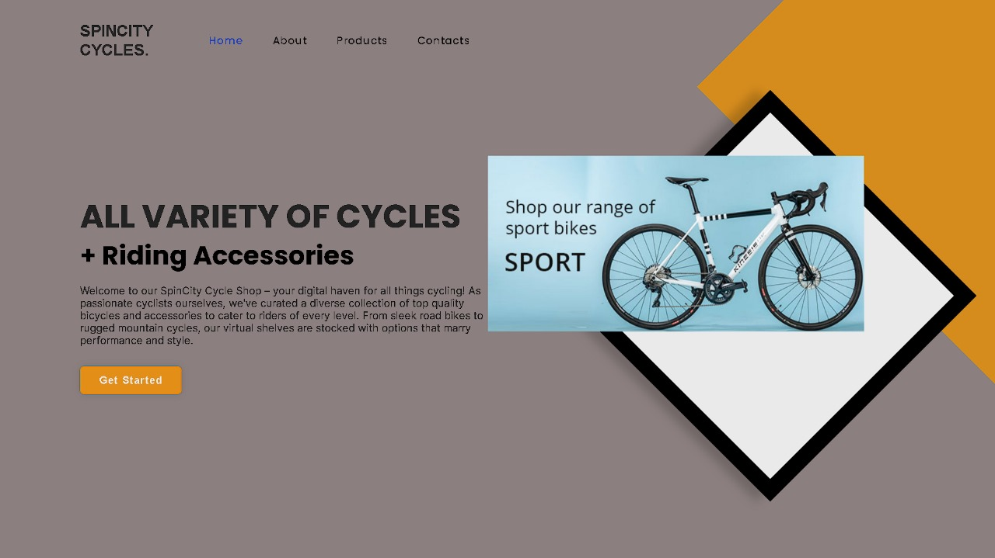
7) USER INTERFACE
Landing Page

Slide 11
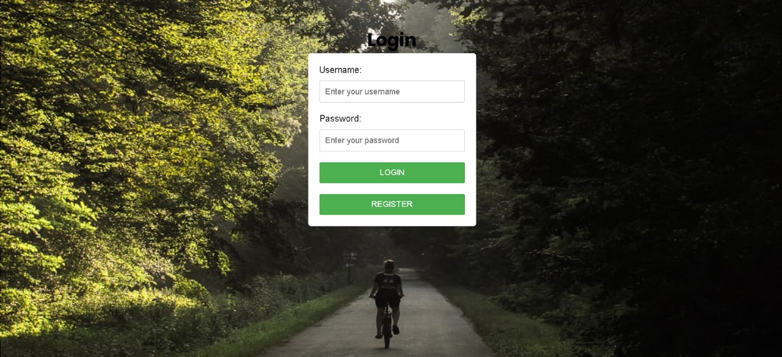
Login Page

Slide 12
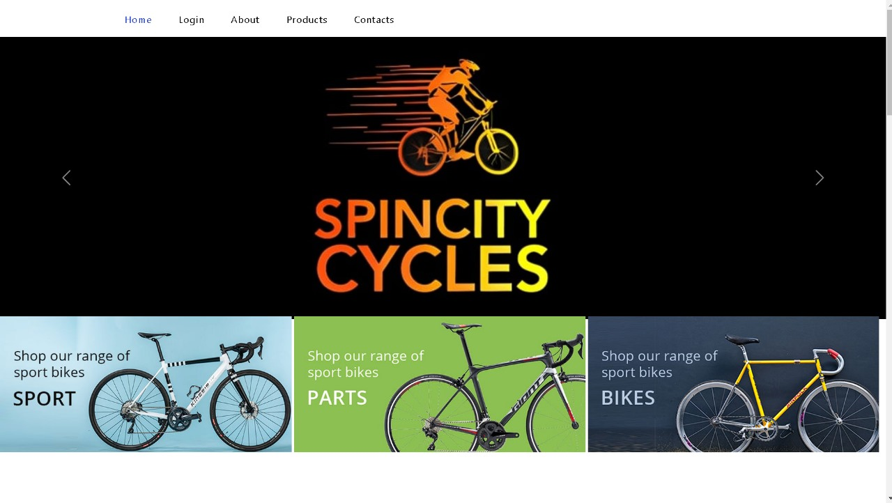
Home Page

Slide 13
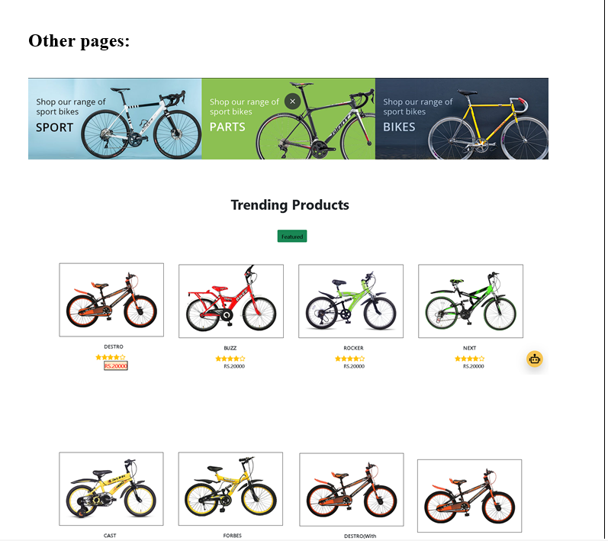
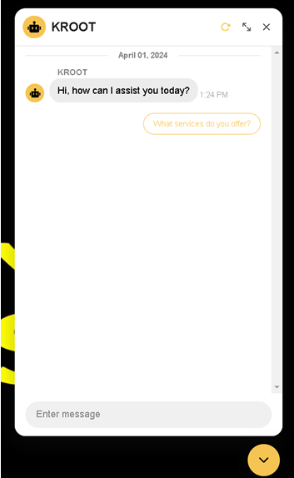
Chat Bot:

Slide 14
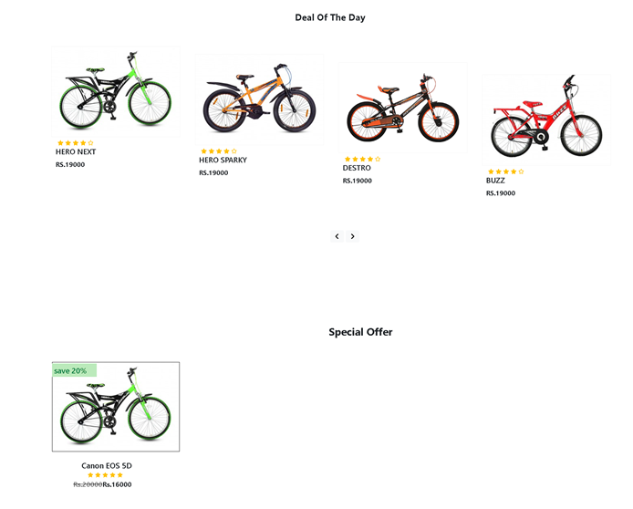
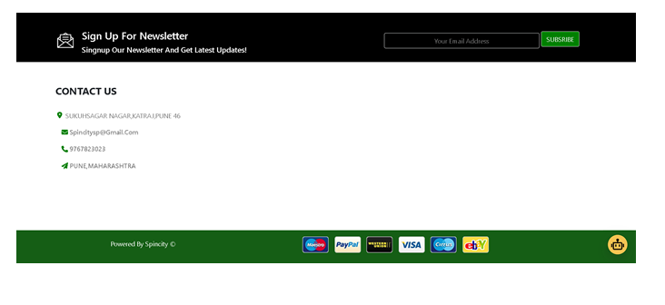
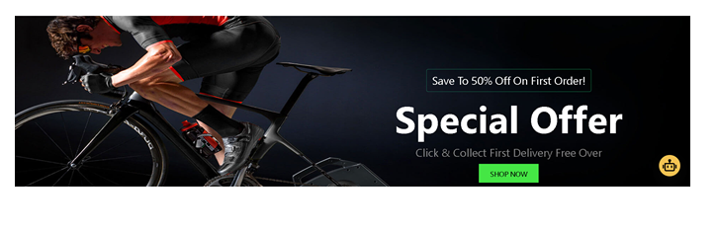
Contact Us Page:

Slide 15
8) IMPLEMENTATION DETAILS
HARDWARE REQUIREMENTS:
Core i5 generation.
Windows 10/11.
Ram 4 GB.
SOFTWARE REQUIREMENTS:
Visual Studio Code.
Chrome Browser.

Slide 16
9) CONCLUSION
Cycle Shop website provides a user-friendly platform for cycling enthusiasts to explore and purchase a wide range of high-quality bicycles and accessories. With its intuitive navigation, detailed product descriptions, the website aims to enhance the overall shopping experience for customers. Whether you're a seasoned cyclist or a novice looking to start your cycling journey, the Cycle Shop website strives to meet your needs and contribute to a seamless and enjoyable shopping experience.
Overall, the Cycle Shop website not only serves as an e-commerce platform but also as a comprehensive resource for cycling enthusiasts, fostering a connection with the cycling community and promoting a healthy and sustainable lifestyle.

Slide 17
10) FUTURE SCOPE
1. Mobile App Development: Develop a dedicated mobile app for Spincity Cycles website to provide users with a seamless and optimized shopping experience on smartphones and tablets. The app can leverage device-specific features and push notifications to enhance user engagement and retention.
2. Community Building Initiatives: Expand community engagement efforts through partnerships with cycling clubs, events, and advocacy groups. Organize virtual and in-person events, workshops, and group rides to foster a sense of community and promote engagement among users.
3. Sustainability Initiatives: Strengthen sustainability initiatives by offering a wider selection of eco-friendly products, implementing recycling programs, and supporting environmental conservation efforts. Educate users on sustainable cycling practices and promote eco-conscious purchasing decisions.
4. Continuous Improvement: Commit to continuous improvement by soliciting feedback from users, monitoring industry trends, and staying abreast of technological advancements. Regularly update the website with new features, enhancements, and optimizations to maintain competitiveness and relevance in the ever-evolving cycling market.

Slide 18
11) BIBLIOGRAPHY AND REFERENCES
Porter, Michael E. Competitive Strategy: Techniques for Analyzing Industries and Competitors." Free Press, 1980.
2. Pucher, John, and Ralph Buehler. "Cycling for Everyone: Lessons from Europe." Transportation Research Record, vol. 2074,
no. 1, 2008, pp. 58-65.
3. Shaw, Jonathan, et al. "Health Benefits of Cycling: A Systematic Review." Scandinavian Journal of Medicine & Science in
Sports, vol. 23, no. 4, 2013, pp. 374-388.
4. Fishman, Elliot, et al. "Bikeshare: A Review of Recent Literature." Transport Reviews, vol. 36, no. 1, 2016, pp. 92-113.
LINKS:-
1. https://www.herocycles.com/store-locator/
2. .https://youtu.be/vpAJ0s5S2t0?si=lCxKiIUao41-cfcB
3. https://youtu.be/BsDoLVMnmZs?si=_jRcvbXZWkogIa8g
4. https://youtu.be/hKB-YGF14SY?si=72xzuktaqHHuErAs

Slide 19
THANK YOU

